Slide 1
E11 - Canny Edge Detection
YIN HANG KWOK

Slide 2
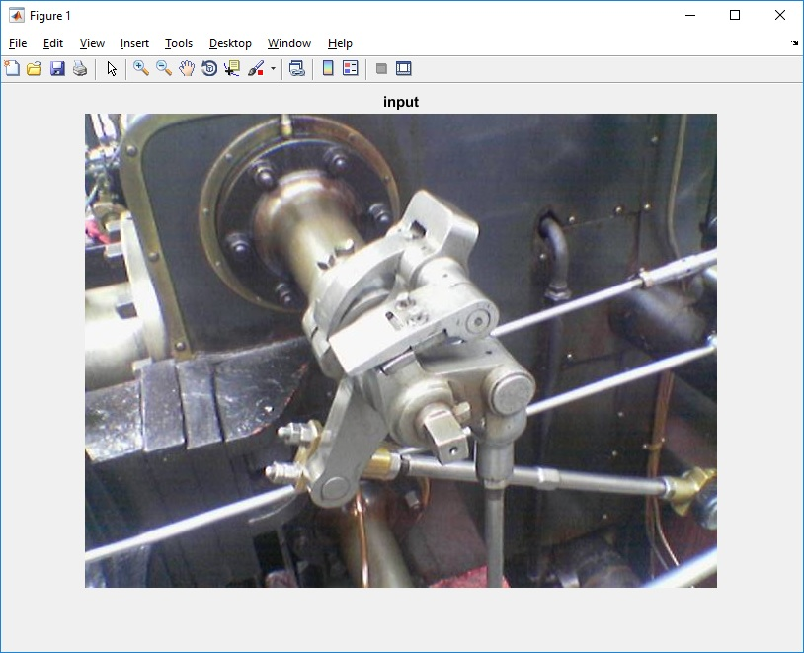
input image

Slide 3
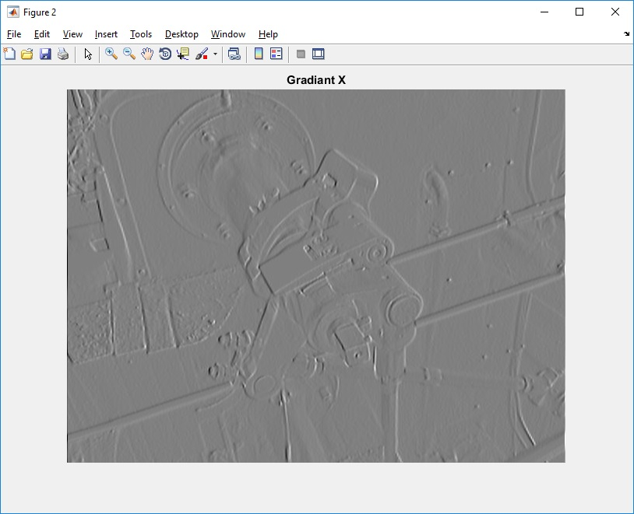
visualization of gradient x

Slide 4
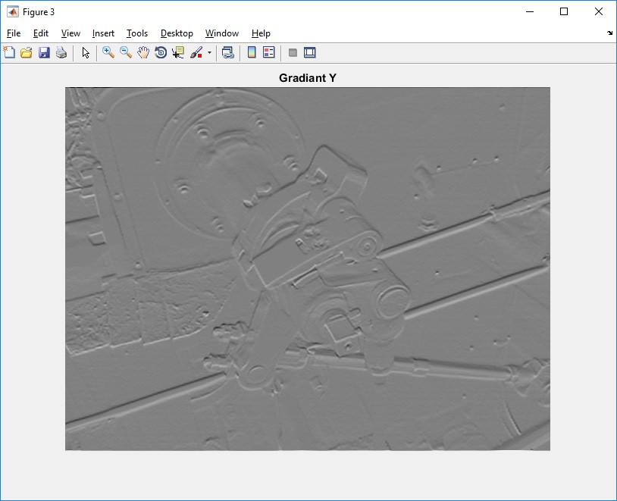
visualization of gradient y

Slide 5
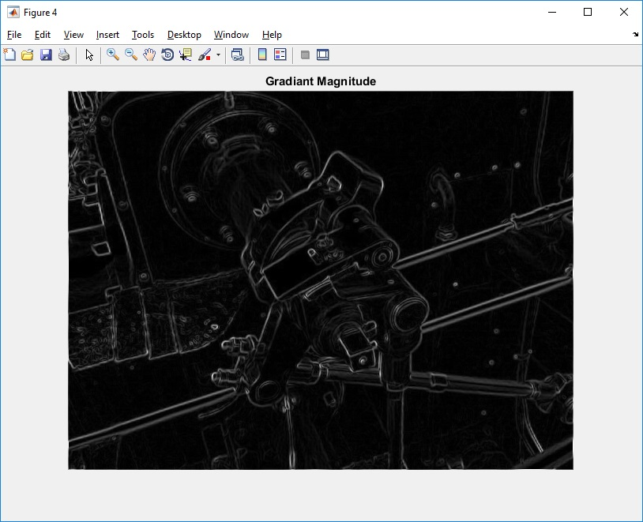
visualization of gradient magnitude

Slide 6
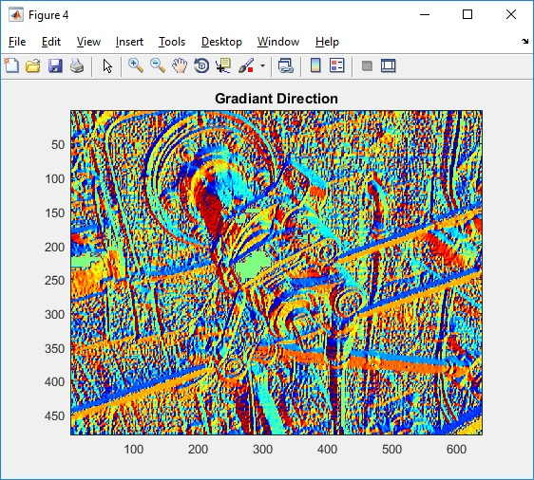
visualization of gradient direction

Slide 7
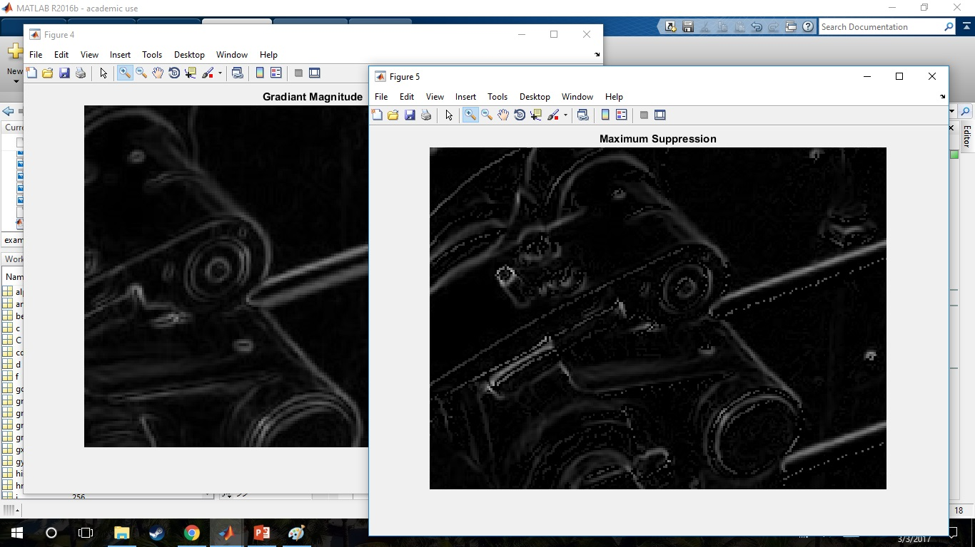
comparison of gradient magnitude with and without non max suppression
Used Non-max suppression, I find that there are few noise around edges.
But some pixels lost.

